Slide 1
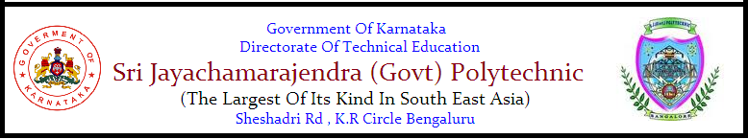
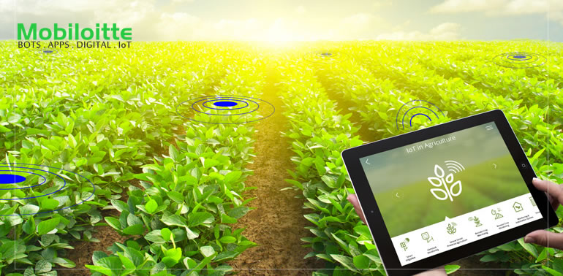
PROGRAMME :DIPLOMA IN COMPUTER SCIENCE & ENGG.
Project Demo On
SMALiv-e
IOT BASED SMART AGRICULTURE AND LIVESTOCK FEEDING MECHANISM
BY,(6th Sem)
DEEPA RANI.B. MAHALAKSHMI.M
SUSHMITHA.A.T. YOGESHWARI.J

Slide 2
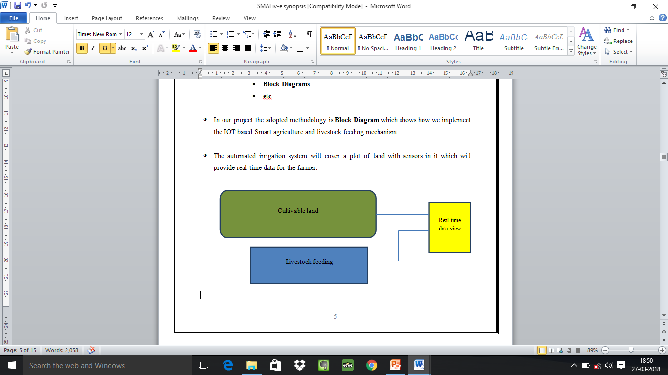
INTRODUCTION
India is an agriculture based country and it is a source of livelihood of majority Indians and has great impact on the economy of the country.
Feeding is the most important factor in successful farming. An animal will only perform at its potential if it is fed well.
In the real world, many farmers face problem in monitoring their farms. The farmers have more difficulties to monitor all the farms at the same time. Hence the project is developed to monitor the farms in the field using the concept of IoT ( Internet of things ).

Slide 3
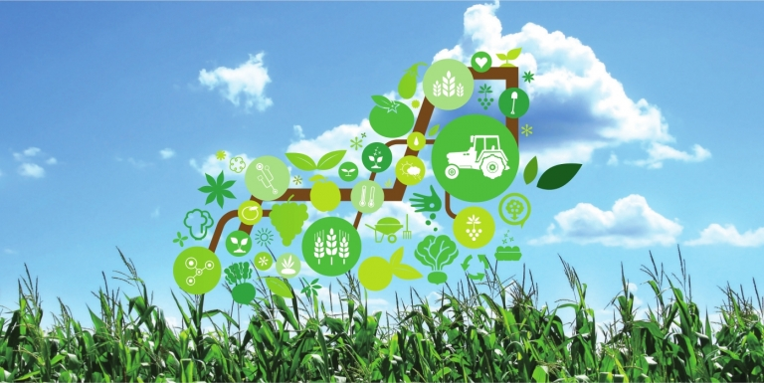
OBJECTIVE OF THE PROJECT
To minimize the manual intervention by the farmer in irrigation activity and feeding the livestock.
Manual means of feeding livestock can be replaced with automatic means of livestock feeding, thus ensuring less wastage of animal feed.
To save the water from being wasted by unplanned usage of water.
To make agricultural field smarter by using Android phones.
To save time ensuring farmers can focus on other activities.
To reduce wastage of crops made by pests using motion detection and also improve security of crops.
To help the farmer to know his field status in his home or he may be residing in any part of the world.

Slide 4
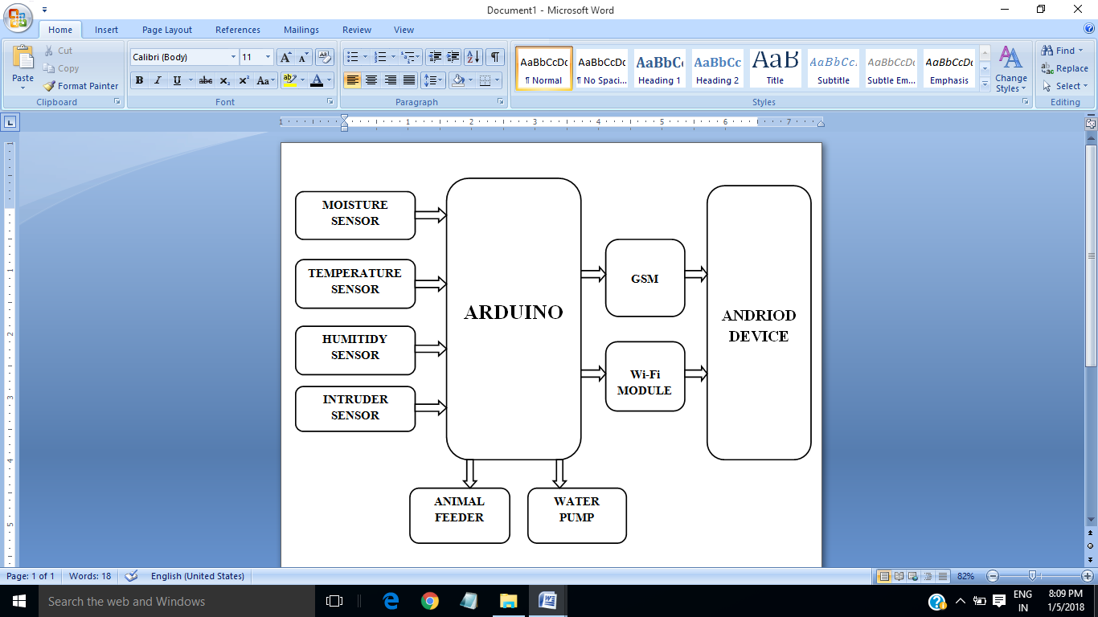
BLOCK DIAGRAM

Slide 5
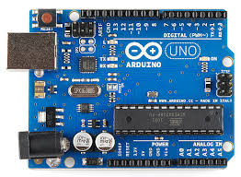
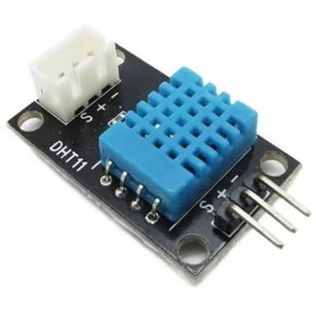
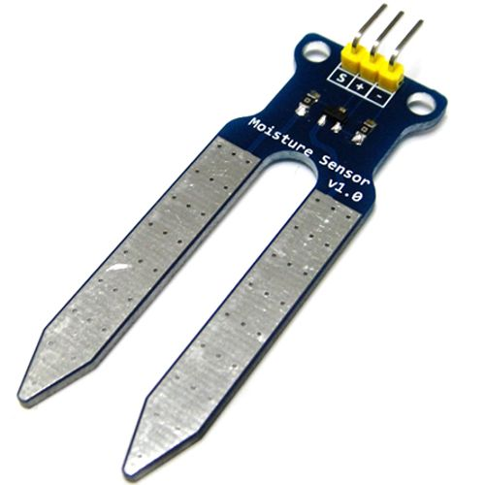
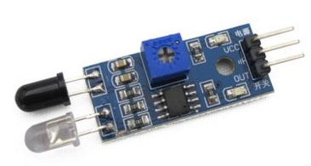
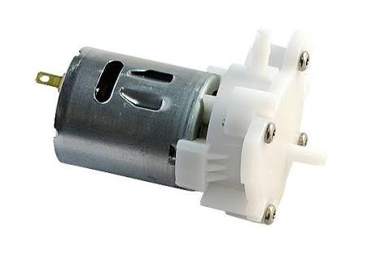
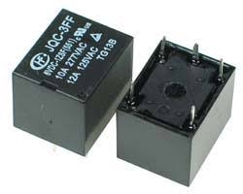
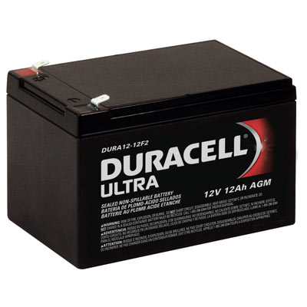
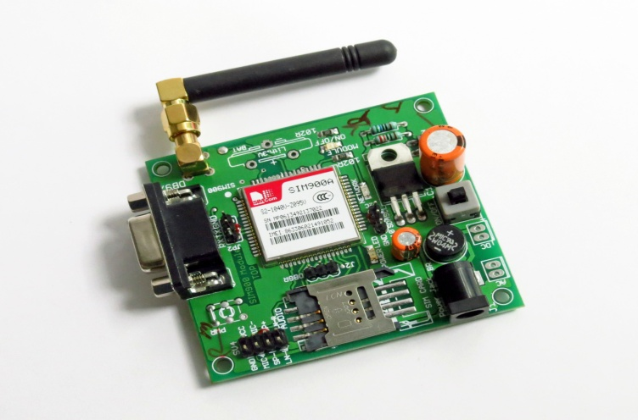
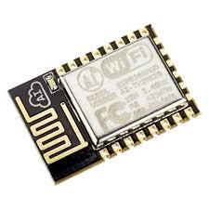
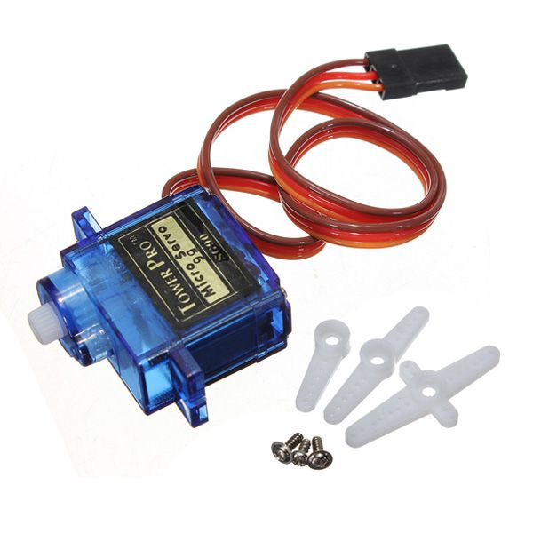
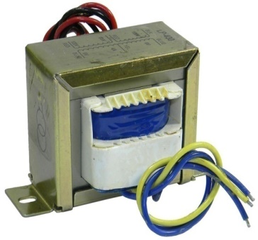
HARDWARES USED

Slide 6


SOFTWARE USED
LANGUAGE USED
Embedded C : Embedded C is a language used for programming the microcontroller.
For app development MIT(Massachusetts Institute of Technology) app inventor tool(open source) is used. It allows to create software applications for Android Operating System.It also supported with the firebase database extension. It allows people to store on Google’s firebase

Slide 7
FUTURE SCOPE
A water meter can be installed to estimate the amount of water used for irrigation and thus giving cost estimation.
A solenoid valve can be used for varying the volume of water flow.
Furthermore, Wireless sensors can also be used.
IoT sensors can be used to track an animal’s location, which can be helpful in locating sick animals as well as establishing and optimizing grazing patterns.
Connected sensors in livestock wearables allow farmers to monitor heart rate, blood pressure, respiratory rate, temperature, digestion, and other vitals.
Light sensor is used to detect light intensity of the environment. Light Dependent Resistor (LDR) is used in which the resistivity decreases with increase in light intensity and vice versa.
LDR is used as sensor to turn on and off electric fence or provide artificial lighting for plantation of necessary. Camera is installed for the purpose of image detection when the movement is detected.

